Slide 1

CGB1121 – PYTHON PROGRAMMING PROJECT REVIEW-2
Department of Information Technology Academic Year: 2024 – 2025 (Even Semester)
Register Number | :927624BIT010
Name | :ANISHA S
Year | : I
Semester | : II
Section | : A
Date | :
1

Slide 2
Title of the Project
Library management
system

Slide 3
Abstract
Library Management Systems are used to manage information about contents in a library. They are used to manage information relating to books, their names, codes, author names, whether they have been issued or not and if so, who has issued them and what their card’s ID is; a library management system is used to store and manage all this information.

Slide 4
Abstract with CO/PO Mapping
Abstract | CO | POs | PSO
The Library Management System (LMS) is a digital solution designed to automate and streamline library operations, replacing traditional manual methods. By integrating an intuitive HTML frontend with a Python backend, the LMS enhances the efficiency of managing library resources, including books, members, and transactions. Key features encompass user registration, book catalog management, loan tracking, and administrative reporting. Utilizing frameworks like Flask or Django for the backend and MySQL or SQLite for database management, the system ensures secure and efficient data handling. This integration results in a comprehensive solution that simplifies library management and improves user satisfaction. | co1,co2 | PO1 PO2 PO3 PO4 PO5 PO6 PO7 PO8 PO9 PO10 PO11 PO12 | PSO1 PSO2 PSO3

Slide 5
Introduction
A Library Management System (LMS) is a digital solution designed to automate and streamline the operations of a library. By integrating a user-friendly HTML frontend with a robust Python backend, such a system enhances the efficiency of managing library resources, including books, members, and transactions.
The frontend, built using HTML, CSS, and JavaScript, provides an intuitive interface for users to interact with the system. HTML structures the content, CSS styles the pages for a pleasant user experience, and JavaScript adds interactivity, such as form validations and dynamic content updates. Frameworks like Bootstrap can be utilized to ensure the frontend is responsive and visually appealing.
On the backend, Python serves as the core programming language, offering simplicity and flexibility. Frameworks like Flask or Django can be employed to handle server-side logic, manage user authentication, and interact with databases. These frameworks facilitate the development of RESTful APIs, enabling seamless communication between the frontend and backend.

Slide 6
Python Programming - Concepts Used
Object-Oriented Programming (OOP)
Classes for Book, Member, etc.
File Handling / Database
Store book and member data.
Functions & Modular Programming
Reusable functions like add_book(), issue_book().

Slide 7
Proposed Architecture
Class Name | Responsibility
Book | Store book details (title, author, etc.)
Member | Info about members (name, ID, books issued)
LibrarySystem | Core functions (add/issue/return/search)
DatabaseHandler | Handle files
+------------------------+
| User Interface | 👤 (Console / GUI with Tkinter)
+------------------------+
↓
+------------------------+
| Application Logic | 🧠 (Functions & Classes)
+------------------------+
↓
+------------------------+
| Data Access Layer | 🗂️ (File or Database Handling)
+------------------------+
↓
+------------------------+
| Data Storage | 💾 (JSON / CSV )
+------------------------+

Slide 8
Proposed Architecture - Description
The Library Management System is a software application designed to manage the daily operations of a library. It helps track books, members, issued/returned books, and fines. The system follows a layered architecture for better structure and maintainability.

Slide 9
List of Modules
Module Name | Purpose
1. Book Management | Add, update, delete, and search books
2. Member Management | Add, update, delete member records
3. Issue Book | Issue books to members and update availability
4. Return Book | Accept returned books and update records
5.Data Storage | Handle saving and loading of data (via files or databases)

Slide 10
Description of Modules
Back-End Modules (Python):
PyQt: These are popular libraries for creating graphical user interfaces (GUIs). while PyQt offers more advanced features for complex GUIs.
Frontend (HTML, CSS, JSON)
1. HTML5 & CSS3
HTML5: Structure and style your web pages.
CSS3: Style your application with modern CSS features.
2.JSON:
Utilized for data interchange between the frontend and backend, especially in API communications.

Slide 11
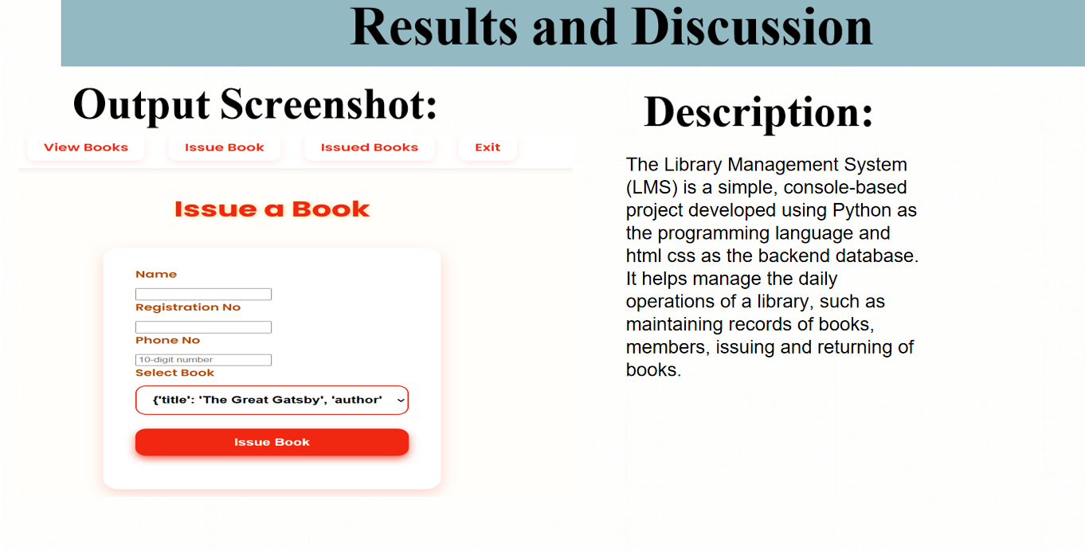

Slide 12
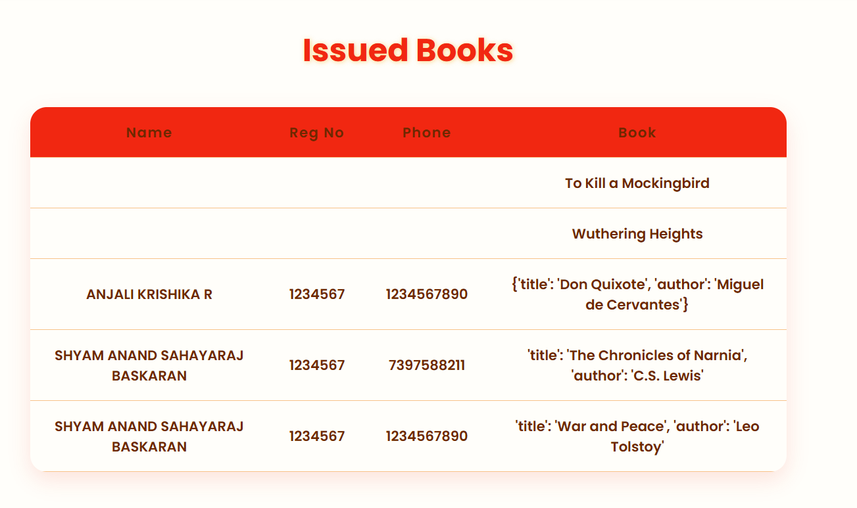
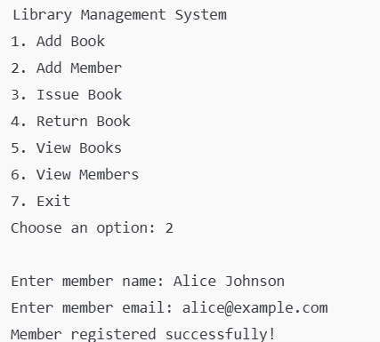
Results and Discussion(Cont..)
Output Screenshot:
Description:
The Library Management System (LMS) is a simple, console-based project developed using Python as the programming language and html ,css as the backend database. It helps manage the daily operations of a library, such as maintaining records of books, members, issuing and returning of books.

Slide 13
Conclusion
The Library Management System in Python provides an efficient and automated solution for managing library operations, such as book issuing, member management, fine calculation, and search. Using object-oriented programming (OOP) ensures a clean, maintainable, and scalable system.

Slide 14
Thank You
ANY QUERIES???

